Slide 1
Automated Diagnosis for Breast Cancer tissue type
Gautham Nandakumar
Saiprasad Sankaranarayanan
Jayanthan Ramesh Vellore

Slide 2
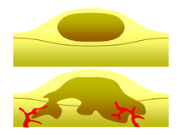
INTRODUCTION
Breast Cancer
Most prominent Cancer in the world
1 in 8 Women in the US diagnosed
Two Types: Benign and Malignant
Malignancy Probability- 20%
Major Challenges:
Determining Malignancy
Better prognosis based on tissue types
Source: https://en.wikipedia.org/wiki/Benign_tumor
Notes:
http://www.breastcancer.org/symptoms/understand_bc/statistics
https://cancer.stonybrookmedicine.edu/breast-cancer-team/patients/bse/breastlumps

Slide 3
Introduction
Due to large number of patients in intensive care units and the need for continuous observation of such conditions, several techniques for automated diagnostic systems have been developed in the past ten years to attempt to solve this problem.
Hence there is need to convert the qualitative data into a format that is numeric and easily read by the computing system.
The quantitative data is deduced from FNA biopsy images.
Wisconsin Breast cancer database. Different features of the cell was studied and the parameter are numbered 1-10.

Slide 4
Application- intro
9 Tissue Characteristics
Application Use
Interface to retrieve information on Subjects (Based on Sample Number)
Build a classifier for new users to test classify the given features
Target users- Oncologists. Application acts as a source of second opinion on the concluded results.
If the database is used to add more samples, it can further be used as a product for the public.
Caution on the user’s intention on using the system. Adding random data to the database, reduces the efficiency of the trained classifier.
System helps improve and save time on the result validation. Most hospitals take weeks together to confirm the results of the biopsy.

Slide 5
Experiments and methods
SQLite Manager- To build Database to create a table with 683 instances and 11 columns:
Sample Number, Clump thickness, uniformity of cell size, Uniformity of cell shape, Marginal adhesion, Single epithelial cell size, Bare nuclei, Bland chromatin, Normal nucleoli and Mitoses
Visualization- Performed using PCA. PCA calculates the eigenvalues and its corresponding vectors. The vectors of the highest 3 eigen values represent 3 principle component axis that displays the most variance among the data
Classification of data into Benign and Malignant- Using Neural Networks. The Network constructed contains 4 hidden layers. . The exported data was distributed into training data, testing data and validation data at a ratio of 7:3:3.
GUI contains 2 functions.
One to act as library search from the database with input being the Sample number.
To test the trained and validated classifier. For this, the GUI asks the user the required 9 features and returns the class (malignant or benign).

Slide 6
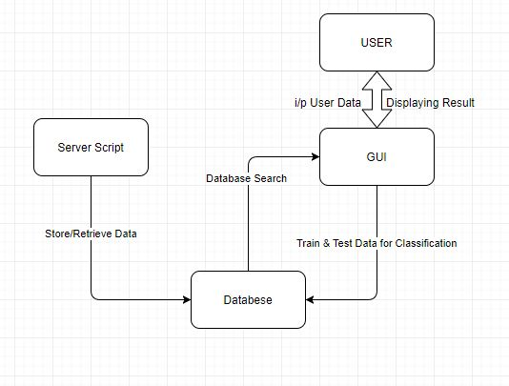
Flow Chart
PHP
SQLITE
MATLAB

Slide 7
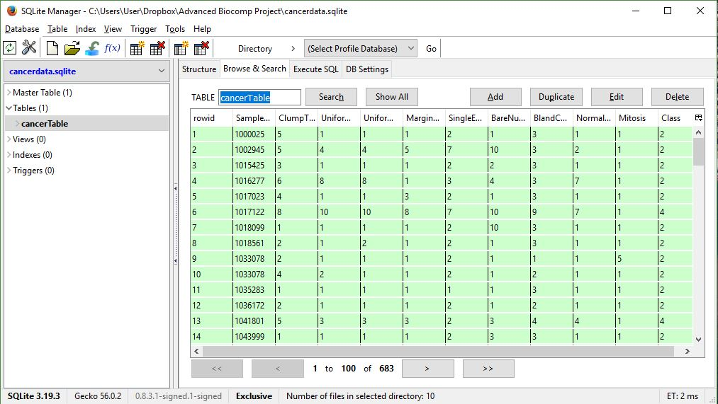
Database- sql

Slide 8
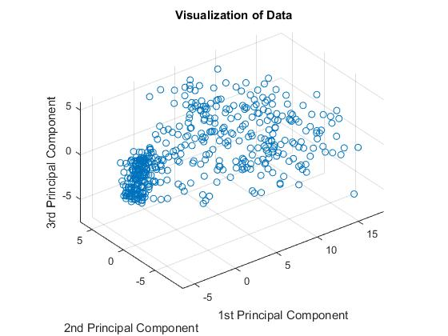
visualization

Slide 9
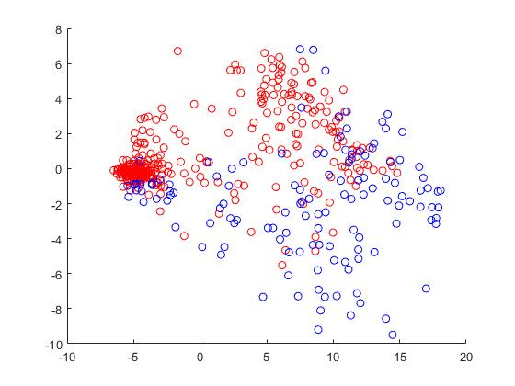
Classification
The data is represented along PC1 and PC2 ( 2D representation). Red is benign and Blue is malignant.
The Neural Network classified the data with an error of 0.2357.

Slide 10
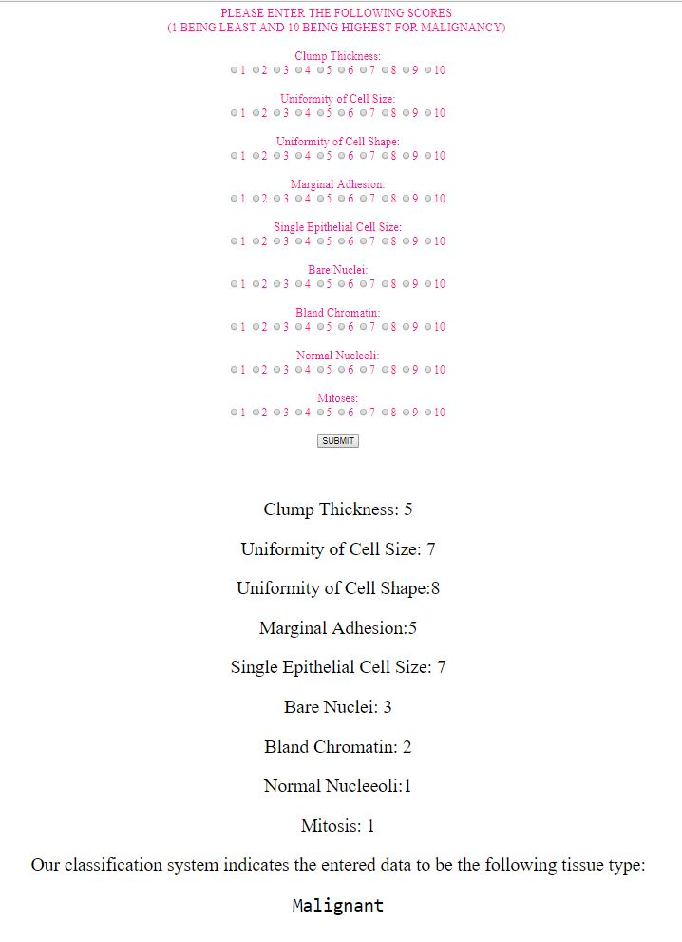
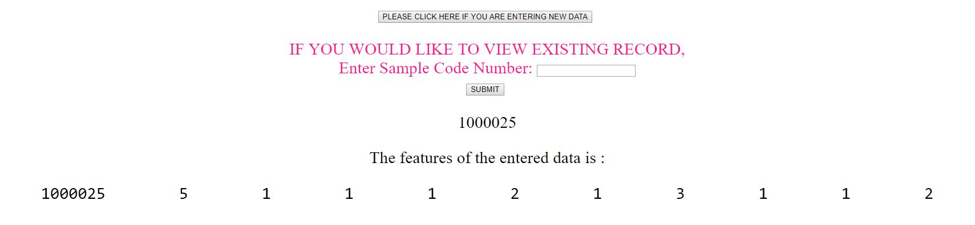
demonstration
Application Use Cases:
Database Search
User Input Data Classification

Slide 11
RESULTS & LIMITATIONS
Results:
Consistent with Existing data
Experimented with values from Dataset
Limitations:
Inaccuracy due to Scoring System
Characteristics shared by both Benign and Malignant Tissues

Slide 12
Future work
Large Dataset:
Option to add input sample data to the dataset
Needs verification and validation by Oncologists
Consistent Scoring:
Well defined/described scores
Use of Reference Images
Input Sample Data
Made available as package to Oncologists worldwide

Slide 13
Thank you
ANY QUESTIONS?

